Slide 1
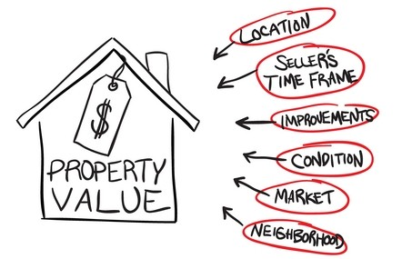
House Price Predictions

Slide 2
OutLine:
Problem Statement
Importing Data
Data Wrangling
Exploratory Data Analysis
Feature Engineering
Machine Learning
Predictions

Slide 3
Problem Statement
Statement
What would be the Features to consider when predicting House Price?
Ask a home buyer to describe their dream house, and they probably won't begin with the height of the basement ceiling or the proximity to an east-west railroad. But this dataset proves that much more influences price negotiations than the number of bedrooms or a white-picket fence.
With 79 explanatory variables describing (almost) every aspect of residential homes in Ames, Iowa, this data set is a challenge to predict the final price of each home. 1459 observations

Slide 4
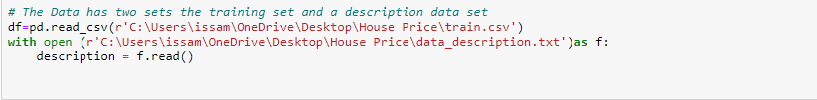
Data and Data Importing
Data
Here is a link for the data set which is provided by by Dean De Cock. It's an incredible alternative for data scientists looking for a modernized and expanded version of the often cited Boston Housing dataset.
Importing Data

Slide 5
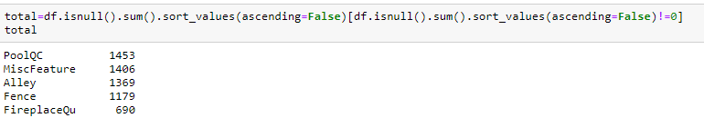
Data Wrangling
The main Challenge with the Data was the nulls
As a data wrangling method to deal with the missing values was to first consult the data description for the null values interpretation

Slide 6
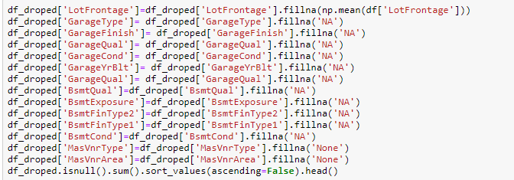
Data Wrangling
Data Wrangling
Now left with one missing value in dataset will drop this missing value by dropping the one observation without affecting the count of the observations or affecting the data.

Slide 7
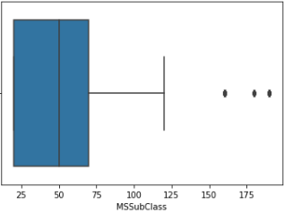

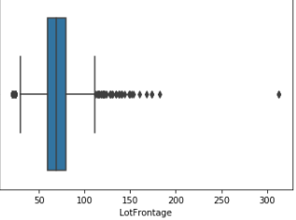

Exploratory Data Analysis
EDA
Checking for Data Anomalies

Slide 8
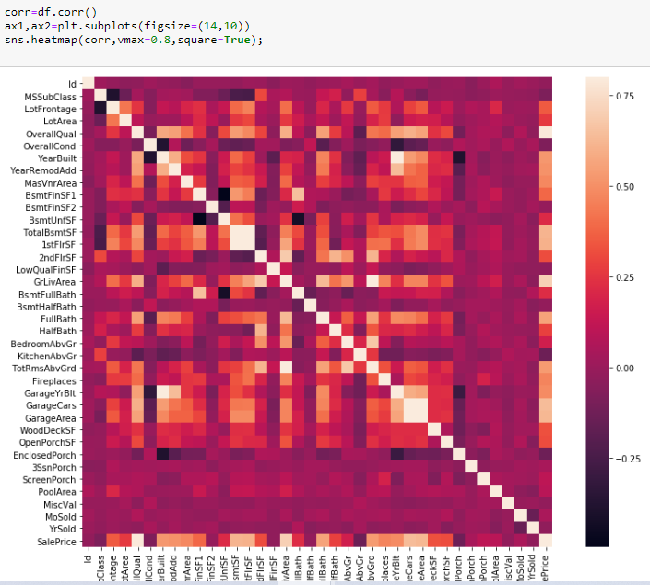
Exploratory Data Analysis
Plotting a Heatmap to vesualize the correlation between the features and the Sale Price

Slide 9
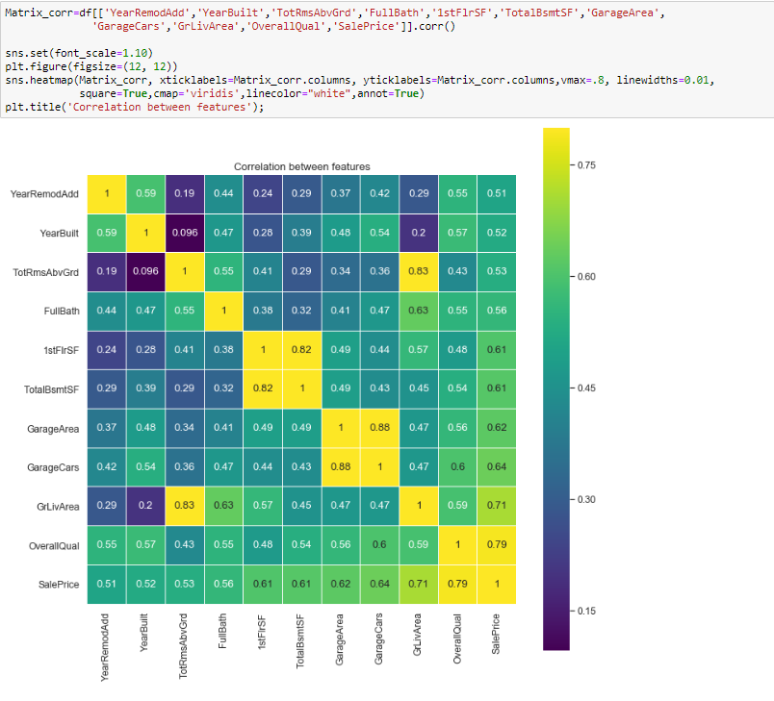
Exploratory Data Analysis
Plotting the correlation between these variable and the Sale Price using a Correlation Matrix to better Visualize

Slide 10
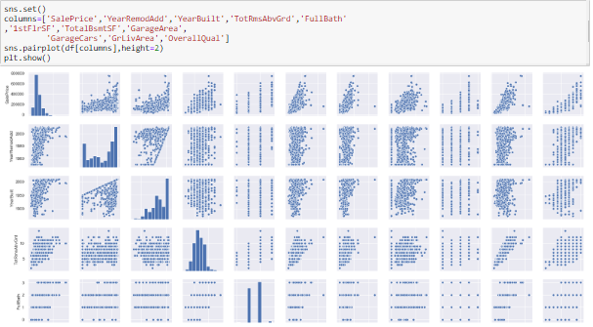
Exploratory Data Analysis
The following is to visualize the correlation and the distribution of the predictor variables and the Sale Price and them among each other

Slide 11
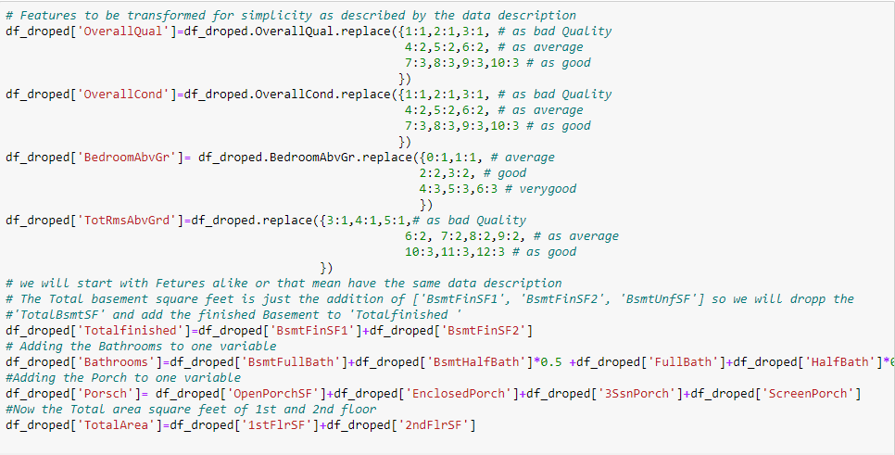
Feature Engineering
Data Preprocessing
Feature engineering involves creating new features and transforming or deleting existing ones. Here below I unified the ranges of bad-average and Good

Slide 12
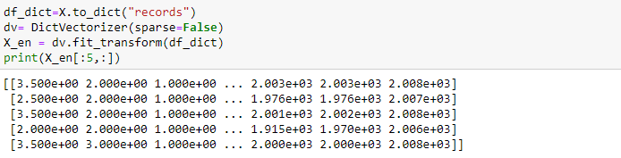
Feature Engineering
The categorical variables to be converted o dummy variables using the DectVectorizer.First transforming the data to a dictionary, applying the DectVectorizer and then transfer it back to dataframe

Slide 13
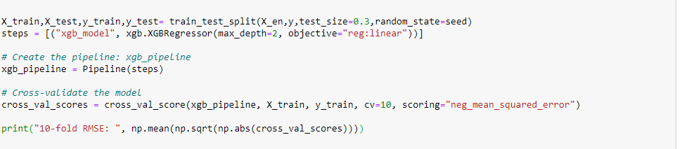
Machine Learning
Modeling
I will use the XGBoost Machine Learning Model on the Data for prediction
First Start by Splitting the Data to test and train data and building a pipeline.

Slide 14
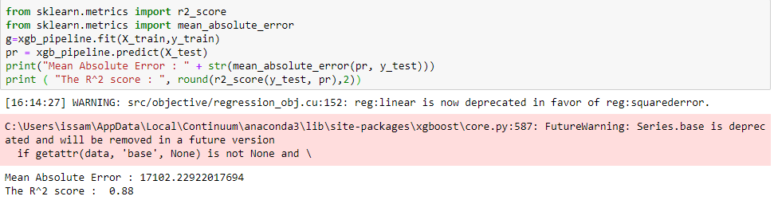
Machine Learning
Initial Model Result
As the result shows a Mean absolute error of $17,102 and Coefficient of determination of 0.88

Slide 15
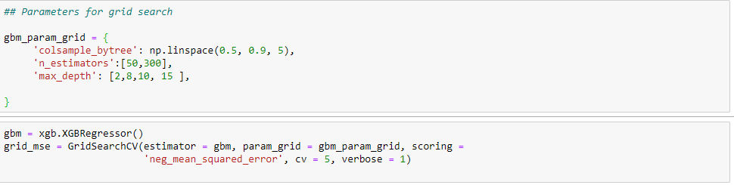
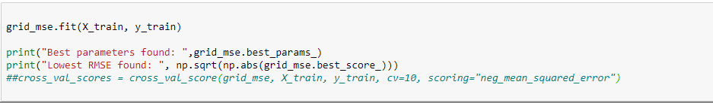
Machine Learning
Model Fine Tuning
To get a better predictive Model we should consider Parameter Fine tuning

Slide 16
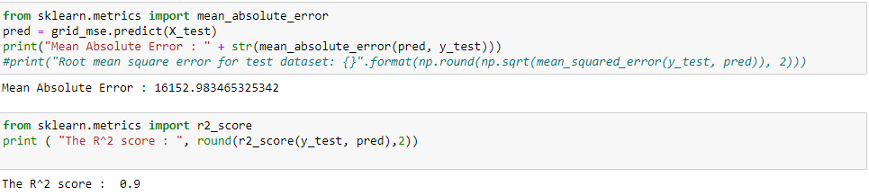
Machine Learning
Fine Tuned Model Result
The new Mean Absolute error is $ 16,152 it dropped by $977 and the coefficient of determination increased to 0.9

Slide 17
Result
The above coefficient of determination is 0.9 which is high enough and I would be satisfied with this Model and the Mean Absolute Error is 16,152.92.00 Where the average price of the house in the data set is 180,921.19.00

